Slide 1


Python + IOT
Course 4
Ver. 01
Copyright @ 2018 Innovaker

Slide 2


Course 3 Summary
Basic introduction of electric circuit
Introduction of Innovaker Digital Circuits Kits
Demo project --- blink LED
2
Copyright @ 2018 Innovaker

Slide 3
quick review basic concept of Electricity
Electricity is the movement of electrons. Electrons create charge, which we can harness to do work. Your lightbulb, your stereo, your phone, etc., are all harnessing the movement of the electrons in order to do work. They all operate using the same basic power source: the movement of electrons.
The three basic principles for this tutorial can be explained using electrons, or more specifically, the charge they create:
Voltage is the difference in charge between two points.
Current is the rate at which charge is flowing.
Resistance is a material’s tendency to resist the flow of charge (current).
3
Copyright @ 2018 Innovaker
Notes:
Teacher notes:
Electricity is a natural phenomenon that occurs throughout nature and takes many different forms. In this tutorial we’ll focus on current electricity: the stuff that powers our electronic gadgets. Our goal is NOT to understand how electricity flows from a power source through wires, lighting up LEDs, spinning motors, and powering our communication devices.
Electricity is briefly defined as the flow of electric charge, but there’s so much behind that simple statement. Where do the charges come from? How do we move them? Where do they move to? How does an electric charge cause mechanical motion or make things light up? So many questions! To begin to explain what electricity is we need to zoom way in, beyond the matter and molecules, to the atoms that make up everything we interact with in life.
We do not have time to discuss and explain all of those concepts in this class, instead, we will focus on the electric circuit, and how its basic concept, and how it works.

Slide 4
What is Innovaker Digital Circuits Kits
Innovaker Digital Circuits Kit, is a special designed STEM kits. Using these tools from the kits, students can focus on electronic theory and programming instead of spending time making tedious wire connections. By undertaking a series of hands-on projects, students will learn how to develop rapid prototypes safely.
Innovaker Digital Circuits Kit includes:
. Pi PCB
. LED
. Resistor
. LCD
. Relay
. Buzzer
. Motion sensor
. Light sensor
. Button with cap
. 1uf Capacitor
. Temperature & Humidity Sensor
. Arduino Nano
4
Copyright @ 2018 Innovaker

Slide 5
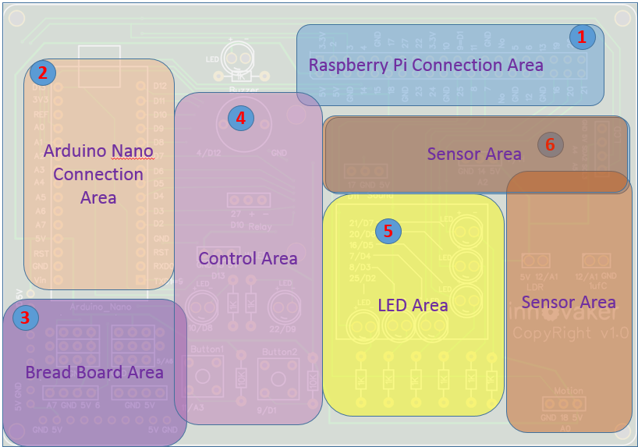
Innovaker Digital Circuits Kits layout
Innovaker Digital Circuits Kit, is a special designed STEM kits. It has built in Arduino Nano, and can connect to external Raspberry Pi.
5
Copyright @ 2018 Innovaker

Slide 6

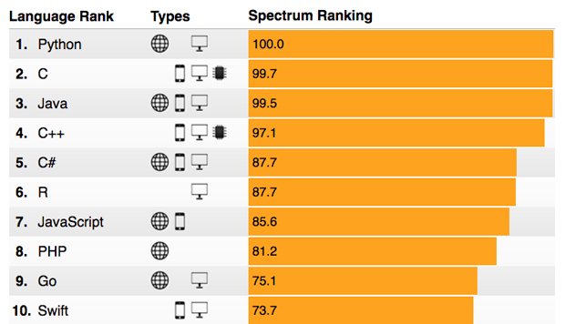
Raspberry Pi
remote access
option 2
Use network cable to connect with router to get IP
Connect Pi with router with ethernet cable, start Pi, the IP will be displayed on LCD, then remote connect to Raspberry Pi through VNC viewer.
Option 1: use monitor / keyboard / mouse to connect to wifi (see previous slide)
Copyright @ 2018 Innovaker
Notes:
IP address
Get Pi IP address is one important step to use Pi with laptop or other computer.
If IP address for example as “192.168.0.15” is displayed on LCD, go to chapter VNC.
Here is workflow how to get wifi IP address:
If there is no IP address is displayed on LCD, there are three ways to get IP.
Use monitor / keyboard / mouse to connect to wifi
Use network cable to connect with router to get IP
Use smartphone hotspot to get IP
Following chapter will introduce above IP methods.
Innovaker Kits special feature (not come with Raspbian)
Option 2: Use network cable to connect with router to get IP
Connect Pi with router with ethernet cable, start Pi, the IP will be displayed on LCD, go to VNC chapter to setup Wifi or use directly.

Slide 7
Raspberry Pi
remote access
option 3
Use martphone hotspot to get IP
Set hotspot on smartphone,
the spot name “Pizhi”, password “innovaker”.
Start Pi with LCD, the LCD will display Pi IP of hotspot, go to VNC, then remote connect to Raspberry Pi through VNC viewer.
Option 1: use monitor / keyboard / mouse to connect to wifi (see previous slide)
Copyright @ 2018 Innovaker
Notes:
Innovaker Kits special feature (not come with Raspbian)
Option 3: Use martphone hotspot to get IP
Set hotspot on smartphone, the spot name “Pizhi”, password “innovaker”.
Start Pi with LCD, the LCD will display Pi IP of hotspot, go to VNC.

Slide 8
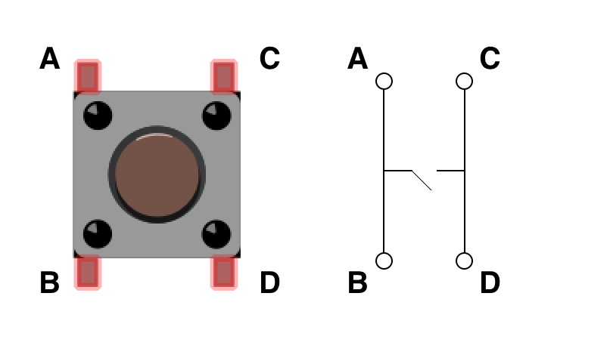
Electronic
component
--- button
Button
buttons can be seen almost everywhere in the world around us in elevators, phones, computers, and much more. Buttons are simply a form of a switch which changes state when it is pressed. Buttons allow us to detect physical changes and convert them into electrical signals.
How does it work?
If you hold the button such that it is in a vertical orientation, then the two rails that are parallel to each other are connected internally. When the button is pressed down, the switch inside closes, connecting the two rails. Current from one branch can then flow across to the other.
Copyright @ 2018 Innovaker
Notes:
Teacher notes:
We will demonstrate our project, first of all, we explain what is button, and how it works
What is a Button?
Buttons can be seen almost everywhere in the world around us in elevators, phones, computers, and much more. Buttons are simply a form of a switch which changes state when it is pressed. Buttons allow us to detect physical changes and convert them into electrical signals.
In order to detect a state change from the button, we will be connecting a 5V power source to the A terminal, a GPIO pin to the B terminal and ground to the C terminal. When the button is in its natural, unpushed state, our GPIO pin will detect the 5V signal as an input. Upon being pushed, however, all four terminals become connected, causing our GPIO pin to be linked with the ground. When it is read in this state, the input that being read will equal that of the ground. Because our button requires very little current in order to function, use a resistor with larger resistance magnitude, either 1k Ω or 10k Ω.
How does it work?
If you hold the button such that it is in a vertical orientation, then the two rails that are parallel to each other are connected internally. When the button is pressed down, the switch inside closes, connecting the two rails. Current from one branch can then flow across to the other.

Slide 9
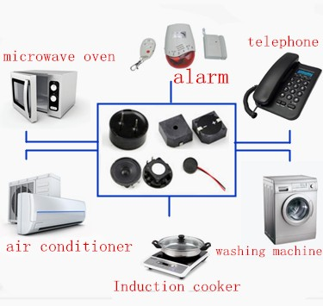
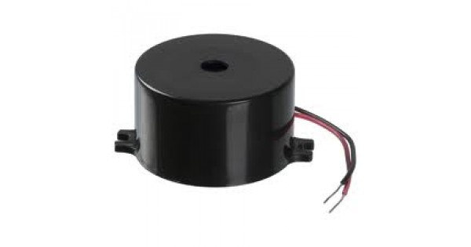
Electronic
component
--- buzzer
Buzzer
A buzzer or beeper is an audio signalling device,^{[1]} which may be mechanical, electromechanical, or piezoelectric (piezo for short). Typical uses of buzzers and beepers include alarm devices, timers, and confirmation of user input such as a mouse click or keystroke.
How does it work?
The buzzer consists of an outside case with two pins to attach it to power and ground.
Inside is a piezo element, which consists of a central ceramic disc surrounded by a metal (often bronze) vibration disc.
When current is applied to the buzzer it causes the ceramic disk to contract or expand. Changing the This then causes the surrounding disc to vibrate. That’s the sound that you hear. By changing the frequency of the buzzer, the speed of the vibrations changes, which changes the pitch of the resulting sound.
Copyright @ 2018 Innovaker
Notes:
Teacher notes:
Buzzers can be both fun and useful in electric circuits.We’ll use them a lot in MakeCrate projects, so let’s take a look at what is going on inside a buzzer to produce sound.
The buzzer consists of an outside case with two pins to attach it to power and ground.
Inside is a piezo element, which consists of a central ceramic disc surrounded by a metal (often bronze)vibration disc.
When current is applied to the buzzer it causes the ceramic disk to contract or expand. Changing the This then causes the surrounding disc to vibrate. That’s the sound that you hear. By changing the frequency of the buzzer, the speed of the vibrations changes, which changes the pitch of the resulting sound.

Slide 10
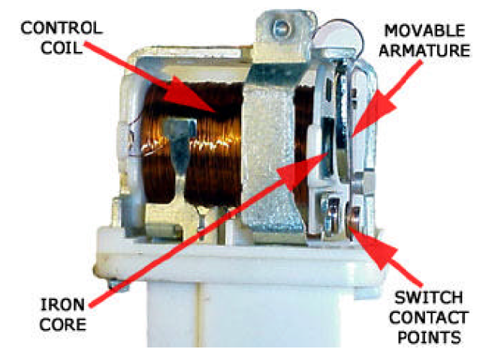
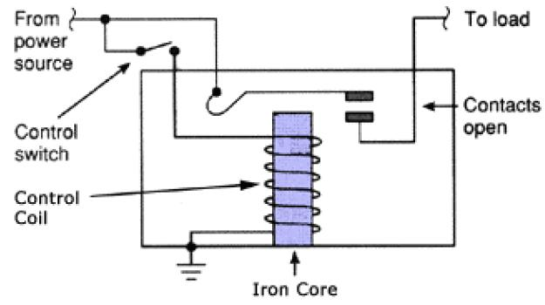
Electronic
component
--- relay
Relay
A relay is an electromagnetic switch operated by a relatively small electric current that can turn on or off a much larger electric current. The heart of a relay is an electromagnet (a coil of wire that becomes a temporary magnet when electricity flows through it).
Copyright @ 2018 Innovaker
Notes:
Teacher notes: http://www.explainthatstuff.com/howrelayswork.html
How relays work
Here are two simple animations illustrating how relays use one circuit to switch on a second circuit.
When power flows through the first circuit (1), it activates the electromagnet (brown), generating a magnetic field (blue) that attracts a contact (red) and activates the second circuit (2). When the power is switched off, a spring pulls the contact back up to its original position, switching the second circuit off again.
This is an example of a "normally open" (NO) relay: the contacts in the second circuit are not connected by default, and switch on only when a current flows through the magnet. Other relays are "normally closed" (NC; the contacts are connected so a current flows through them by default) and switch off only when the magnet is activated, pulling or pushing the contacts apart. Normally open relays are the most common.
Here's another animation showing how a relay links two circuits together. It's essentially the same thing drawn in a slightly different way. On the left side, there's an input circuit powered by a switch or a sensor of some kind. When this circuit is activated, it feeds current to an electromagnet that pulls a metal switch closed and activates the second, output circuit (on the right side). The relatively small current in the input circuit thus activates the larger current in the output circuit:
The input circuit (black loop) is switched off and no current flows through it until something (either a sensor or a switch closing) turns it on. The output circuit (blue loop) is also switched off.
When a small current flows in the input circuit, it activates the electromagnet (shown here as a red coil), which produces a magnetic field all around it.
The energized electromagnet pulls the metal bar in the output circuit toward it, closing the switch and allowing a much bigger current to flow through the output circuit.
The output circuit operates a high-current appliance such as a lamp or an electric motor.

Slide 11
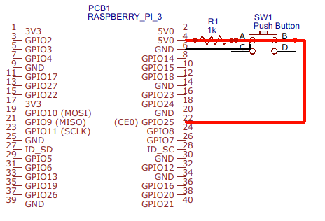
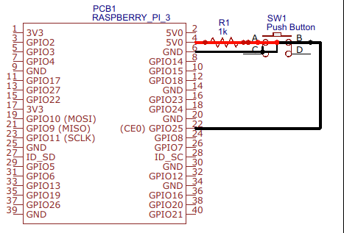
Demo Project
button control I
diagram
Copyright @ 2018 Innovaker
Notes:
Teacher notes:
There are two different ways that we can read a GPIO input from a button. The first method, called polling, involves continuously checking for an input using a loop. This can potentially be faulty if the input is read at the wrong time and can be processor intensive at times. The other method is using interrupts, which listens for changes in the state of the buttons rather than what the state is.

Slide 12
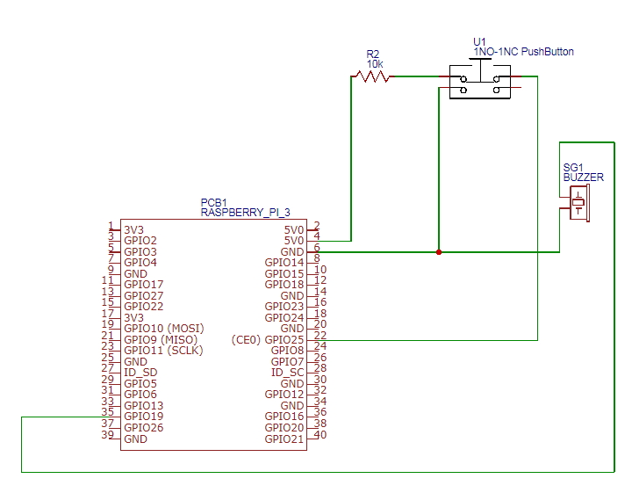
Demo Project
button control II
diagram
Copyright @ 2018 Innovaker
Notes:
Teacher notes:

Slide 13
Demo Project
button control III
import RPi.GPIO as GPIO import time
BUTTON_PIN = 11 BUZZER_PIN = 4 ON = True OFF = False
def setup(): GPIO.setmode(GPIO.BCM) GPIO.setup(BUTTON_PIN, GPIO.IN, pull_up_down=GPIO.PUD_UP) GPIO.setup(BUZZER_PIN, GPIO.OUT) | Notice how the button setup differs slightly from that of the other pins. GPIO.setup(BUTTON_PIN, GPIO.IN, pull_up_down=GPIO.PUD_UP) - the button setup takes a third parameter, a function, to determine which state the button is naturally in.
Copyright @ 2018 Innovaker
Notes:
Teacher notes:
Writing the Code (button1.py)
Run the following programs that sound a buzzer whenever a button is pressed. Take note of the two different ways in which we can listen for button presses.

Slide 14
Demo Project
button control IV
def main(): while True: time.sleep(0.01) if(GPIO.input(BUTTON_PIN) == 0): print ("Button is pressed!") print ("Buzzer will be turn on!") GPIO.output(BUZZER_PIN, ON) else: GPIO.output(BUZZER_PIN, OFF) | GPIO.input(BUTTON_PIN) - Reads the status of the GPIO pin. When the pull_up_down status is GPIO.PUD_UP, the natural state is a 1 while a push is a 0
if __name__ == '__main__': try: setup() main() finally: GPIO.cleanup()
Copyright @ 2018 Innovaker
Notes:
Teacher notes:

Slide 15
Demo Project
button control V
import RPi.GPIO as GPIO import time
BUTTON_PIN = 11 BUZZER_PIN = 4 ON = True OFF = False
def setup(): GPIO.setmode(GPIO.BCM) GPIO.setup(BUTTON_PIN, GPIO.IN, pull_up_down=GPIO.PUD_DOWN) GPIO.add_event_detect(BUTTON_PIN, GPIO.BOTH, callback=button_callback, bouncetime=200) GPIO.setup(BUZZER_PIN, GPIO.OUT) | This version of attaches a callback function as a parameter to the GPIO.add_event_detect function. The callback runs whenever an event is detected from the button. The callback that we pass in here is defined below.
Copyright @ 2018 Innovaker
Notes:
Teacher notes:
A callback is a function provided by the consumer of an API that the API can then turn around and invoke (calling you back). If I setup a Dr.'s appointment, I can give them my phone number, so they can call me the day before to confirm the appointment. A callback is like that, except instead of just being a phone number, it can be arbitrary instructions like "send me an email at this address, and also call my secretary and have her put it in my calendar.
Callbacks are often used in situations where an action is asynchronous. If you need to call a function, and immediately continue working, you can't sit there wait for its return value to let you know what happened, so you provide a callback. When the function is done completely its asynchronous work it will then invoke your callback with some predetermined arguments (usually some you supply, and some about the status and result of the asynchronous action you requested).
If the Dr. is out of the office, or they are still working on the schedule, rather than having me wait on hold until he gets back, which could be several hours, we hang up, and once the appointment has been scheduled, they call me.
In this specific case, Parallel Python's submit function will invoke your callback with any arguments you supply and the result of func, once func has finished executing.

Slide 16
Demo Project
button control VI
def main(): while True: print("I'm working...") time.sleep(0.01) GPIO.setup(BUZZER_PIN, GPIO.LOW)
def button_callback(channel): print("button pressed!") BuzzerStatus = GPIO.input(BUZZER_PIN) if BuzzerStatus: GPIO.output(BUZZER_PIN, GPIO.LOW) else: GPIO.output(BUZZER_PIN, GPIO.HIGH) | This is the callback function that is passed in to the event detection in the setup phase. This function is run whenever our button detects a change in events.
Copyright @ 2018 Innovaker
Notes:
Teacher notes:

Slide 17
Demo Project
additional demo
Copyright @ 2018 Innovaker
Notes:
Teacher notes:
additional demo
How to show more demo of use the button + LED + resistor circuit
combine the button control LED with buzzer to play some kind of famous piece of music (such as happy birthday)

Slide 18
summary
What we learned so far?
. Introduction of Innovaker Digital Circuit Kit
. Basic concept of electric circuit
. Demo project --- button control buzzer
Copyright @ 2018 Innovaker
Notes:
Teacher notes:
Writing the Code (led.py)
To ensure that your program is readable to both computer and human eyes, make sure that you structure your programs in a way that coherent on what the purpose of the program is. This will also eliminate many of the bugs that occur in your code.

Slide 19

Congratulations On Finishing
Copyright @ 2018 Innovaker

